Slide 1
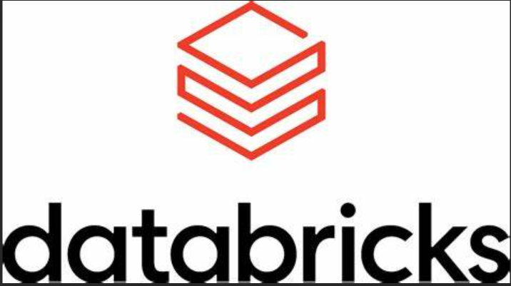

Databricks Spark Learnings
By: Sakshi Narayanaswamy

Slide 2
Basics of Spark

Slide 3
What is Spark?
Spark is an open source distributed computing engine. It is used for processing and analysing a large amount of data. Like Hadoop, spark also works in distributed nature but differs in in-memory processing.
Compared to Hadoop or traditional systems, spark is 100 times faster in memory and 10 times faster in disc.
Spark’s lightning speed is from in memory and parallel processing
Spark has well designed layered architecture. It follows master/slave concept. That is driver(master) and worker(slave) concept. Between driver and worker layer comes cluster manager layer. These layers driver, worker and cluster manager and designed well within its boundary and loosely coupled to each other.

Slide 4
Spark Architecture
Driver
Cluster Manager
Worker1
Executor
Worker2
Executor
Worker N
Executor

Slide 5
Driver Node Architecture
Driver JVM Process
Code
Spark Initialisation
DAG scheduler
Task scheduler
Cluster Manager
Output Tracker
Deploy Scheduler
Worker Nodes

Slide 6
Worker Node Architecture
Worker Node : 64 core processor + 128 GB Memory
RDD size : 2GB
Partition : 200
Executors : 4
Partition size = 2000MB/200 = 10MB
Partition/Executor = 50
Executor 1 (32 GB RAM)
16 Cores
On heap memory
Executor 2 (32 GB RAM)
16 Cores
On heap memory
Executor 3 (32 GB RAM)
16 Cores
On heap memory
Executor 4 (32 GB RAM)
16 Cores
On heap memory
On heap memory = 50% Storage memory + 50% Execution Memory (Reserved memory + User memory + Unified memory)

Slide 7
Lifecycle of Spark Application
Users submits Application
(Code submission)
Driver establishes connection with worker and assigns tasks
Worker executes the task and returns results to driver
Cluster manager allocates resources to execute task
Driver Initiates Spark Session
Driver returns the result to user
DAG(Directed acyclic graph) creates logical plan
Task executor requests for resources from cluster manager
Application comes to end

Slide 8
Attributes of Spark
Scalable: Worker nodes can be increased/ decreased depending on the tasks
Fault Tolerant : Follows lazy evaluation model. Once task is assigned → it forms a graph in DAG and then only it will initialize the worker node. So if the worker node fails also the details can be extracted from the graph and assign it to other healthy worker node
Polyglot: Spark supports multiple languages of programming( Scala, java, python, SQL, R )
Real Time: It can handle streaming service
Speed: It adopts in memory framework + parallel processing
Rich libraries : Like data science, ML etc ( SQL, Streamin, Mllib, GraphX )

Slide 9
Important Terminologies in Spark Part-1
Application: Piece of code for execution
Jobs: Once Application is submitted to spark, driver process converts the code into job
Stage: Jobs are divided into stages based on the need across the cluster
Tasks: It will be divided into multiple tasks. In a stage all tasks would execute same logic.
Transformations: Transforms input RDD and create new RDD
DAG: Directed Acyclic Graph keeps track of all transformations and creates a logical plan and lineage graph is maintained.
RDD(Resilient Distributed Datasets) : Basic data structure of Spark

Slide 10
Important Terminologies in Spark Part-2
Executor: Each worker node can consist of many executors. It can be configured by spark settings
Partition: RDD/Data frame is stored in memory of cluster in the form of partition.
Core: Each executor consists of multiple cores. This is configurable by spark settings. Each core can process one task at a time
On heap memory: The executor memory that lies within JVM process managed JVM
Off heap memory: The executor memory that lies outside JVM process managed by OS

Slide 11
RDD, Data frame, Data set
They are APIs provided by spark for developers for data processing and analytics.
In terms of functionality all are same and returns same output for provided input data. But they differ in the way of handling and processing data. So there is difference in terms of performance, user convenience and language support etc.
Users can choose any of the API while working with spark.
RDD
Spark 1.0
2011
Data frame*
Spark 1.3
2013
Dataset
Spark 1.6
2015
Data frame is immutable*

Slide 12
Advantages of Dataset
Dataset is the combination of Best of RDD and Best of Data frame
Qualities of RDD(Resilient Distributed Datasets):
Programming control OOPs
Type Safety
Best of Data frame:
Relational Format
Optimization
Memory Management
Dataset
RDD
Data frame

Slide 13
Difference Between RDD & Data frame & Dataset
RDD Program tells how to do OOP’s Style API On heap JVM objects Serialization unavoidable GC impacts performance(Garbage Collector) Strong type Safety No optimization Compile Time Error Java, Scala, Python and R No Schema | Data Frame Program tells what to do SQL Style API Off heap also used Serialization can be avoided (off heap) GC impact mitigated Less type Safety Catalyst Optimizer Run Time Error Java, Scala, Python and R Schema Structured | Dataset Program tells what to do OOPs Style API Off heap also used Serialization can be avoided (encoder) GC impact mitigated Strong type Safety Optimization Compile Time Error Scala and Java Schema Structured

Slide 14
Transformation And Action
Transformation
Transformation is kind of operation which will transform Data frame from one form to another . We will get new data frame after execution of each transformation operation . Transformation is lazy evaluation based on DAG(Directed Acyclic Graph). Filter, Union etc.
Action
When we want to work with actual data, call the action. Action returns the data to driver for display or storage into storage layer. Count, collect, Save etc.

Slide 15
Lazy Evaluation & DAG
Filter Records
Concatenation
Source Data
Data Frame
1
Transform
Data Frame
2
Transform
Read External Data
DAG Update
Write Data frame
S3 Bucket Output
Data Frame
3
Action
DAG Execution

Slide 16
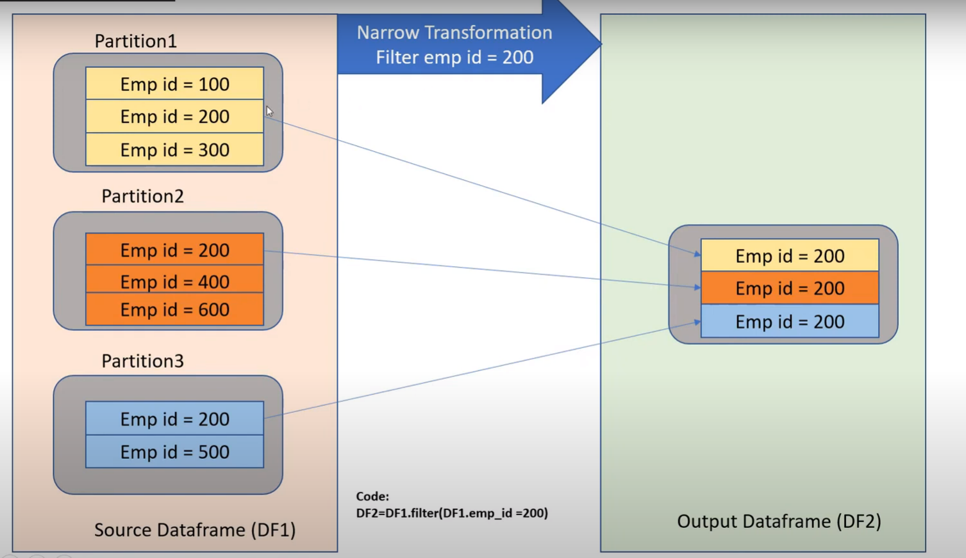
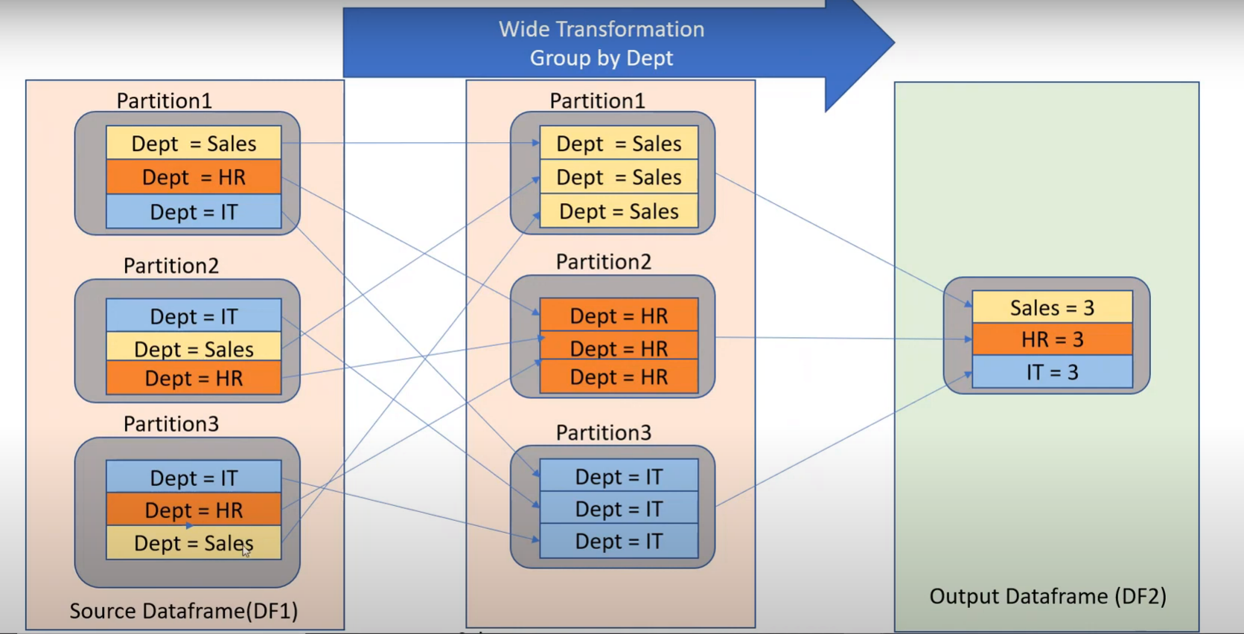
Types Of Transformation
Narrow Transformation
Wide Transformation

Slide 17
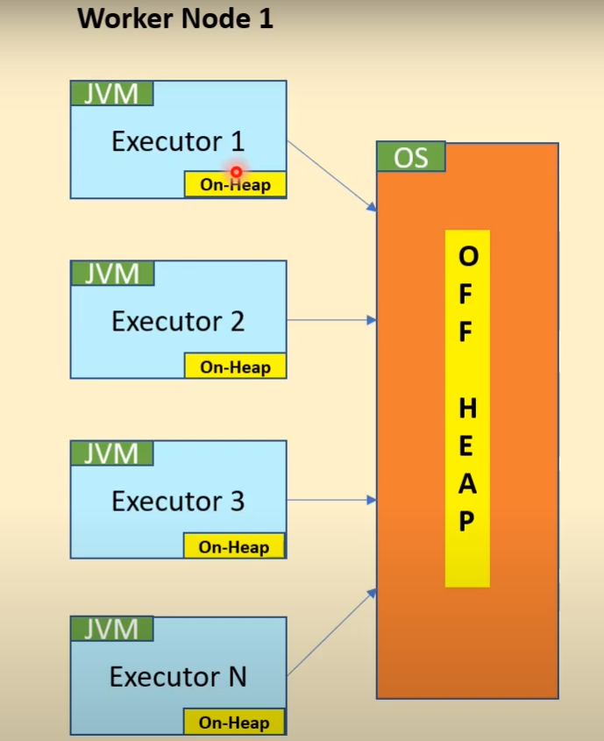
On Heap vs Off Heap Memory
On Heap Memory: Memory which is managed by the JVM is called On heap memory
On Heap memory = Reserved Memory + Unified memory + User Memory
Where,
Unified Memory = Execution Memory(50%) + Storage Memory(50%)
Reserved Memory = Reserved for spark’s internal purposes User Memory = Stores data structures during aggregations/shuffling
Off Heap Memory: Memory which is managed by the OS not by the JVM

Slide 18
On Heap vs Off Heap
On Heap Memory Better Performance than off-heap because object allocation and deallocation happens automatically Managed and controlled by garbage collector within JVM process so adding overhead of GC scans Data stored in the format of java bytes (deserialized ) which java can process efficiently While processing smaller sets of data that can fit into heap memory , this option is suitable | Off Heap Memory Slower than On heap but still better than disc performance. Manual memory management Directly managed by OS so avoiding the overhead of GC Data stored in the format of array of bytes(serialized). So adding overhead of serializing/deserializing when java program needs to process the data. When need to store bigger dataset that cannot fit into heap memory , can make advantage of off-heap memory to store the data outside JVM process

Slide 19
What is Cluster?
Cluster is a computing infrastructure in data bricks environment
It is a set of computation resources and configurations
Cluster is the infrastructure which executes data engineering , data analytics and data science workloads that are developed in data bricks notebook
All purpose Cluster: These are used to execute and analyse data collaboratively using interactive notebooks . We can manually terminate and restart an all purpose cluster . Multiple users can share such clusters to do collaborative interactive analysis.
Job cluster: Job clusters are used to run fast and robust automated jobs . These are created automatically at the start of execution and terminates the cluster at the end of execution.
Pools: Databricks pools are created to reduce the boot time and auto scaling. Clusters are attached to pools and pool is configured with set of idle and ready to use instances . So when we attach a cluster from pool to notebook , there would always be instances ready to use. When job got executed cluster will return back to pool.

Slide 20
Modes & Runtime of Cluster
Modes
Standard: This mode is suitable for single user. If no team collaboration is needed , we can go for this mode.
High Concurrency: This mode is suitable for collaboration. It provides fine grained sharing for maximum resource utilization and minimum query latencies.
Single Node: This mode runs the job only in driver node and no worker nodes are provisioned.
Runtime
Runtime is a set of core components that are needed for cluster to run. Based on runtime choice , it differs in usability, performance and security.
Several options are provided by cluster and can be chosen based on the needs

Slide 21
Azure Databricks

Slide 22
Features of Spark
Apache Spark is a lightning-fast unified analytics engine for big data processing and machine learning. It is used by yahoo, ebay, Netflix
100 % open source
Provides simple and easy to use APIs
In-Memory Processing engines
Distributed Computing Platform
It provides a Unified engine which supports SQL, streaming, ML and graph processing (spark SQL, Spark Streaming, Spark ML, Spark Graph Data frame, API’s)

Slide 23
Architecture of Spark
Spark SQL Spark Streaming Spark ML Spark Graph
Data frame/APIs
Spark SQL Engine
Catalyst Optimizer Tungsten(For memory)
Spark Core
Scala Python JAVA R
Resilient Distributed Dataset

Slide 24
Databricks
Databricks is a company founded by the creators of Apache Spark to make it easier to work with Spark on the Cloud.
In order for Spark to do its distributed computing, we need to spin up Clusters and install the software. Databricks gives you the ability to spin up the Clusters with a few clicks. You can choose the runtime, which is suitable for your needs. For example, you can choose a runtime with ML libraries, support for GPU, etc. Also, you can choose from a wide range of Clusters ranging from general purpose, memory optimized, compute optimized, or GPU enabled.
It provides a Jupyter Notebook style IDE with additional capabilities to create your application.
It provides administration controls that you can use to restrict or provide access to your users, to the workspace, Clusters . On top of this, Databricks provides the Spark runtime, which is highly optimized for the Databricks platform

Slide 25
Features provided by Databricks
Clusters
Workspace/Notebook
Admin Controls
Optimized Spark
Databases/Tables
Delta Lake
SQL Analytics
ML Flow

Slide 26
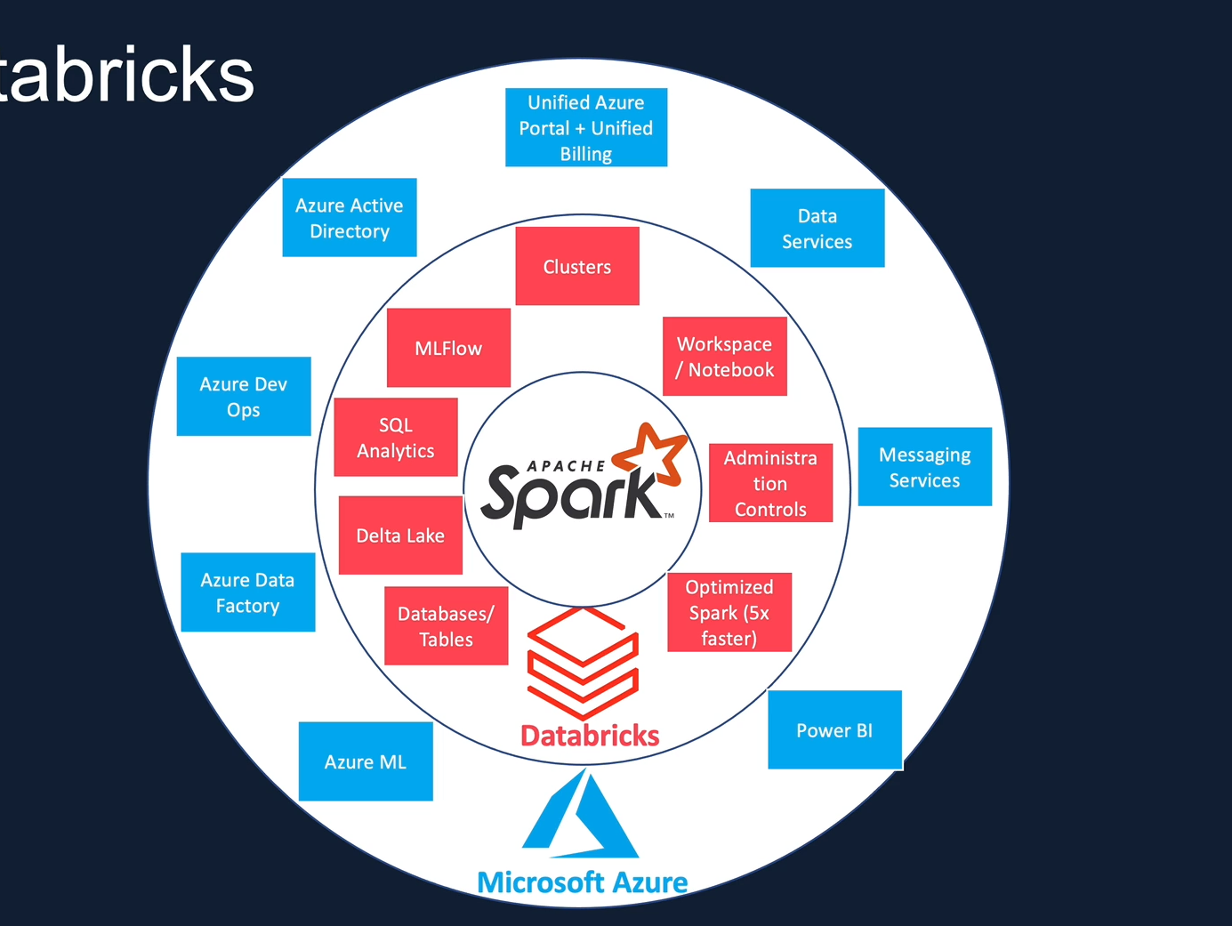

Azure Databricks

Slide 27
Azure Databricks Architecture
Control Pane
(Databricks Subscription)
Azure Resource Manager
Azure AD
Data Pane
(Databricks Subscription
Databricks cluster Manager
Users
Databricks Ux
VNet
Netwrk Security Grp
Databricks
workspace
DBFS
Clusters
VM
VM
VM
VM
Azure Blob Storage

Slide 28
Cluster and Its Types
Clusters are nothing but the collection of virtual machines
All Purpose Cluster Created Manually Persistent Suitable for interactive workload Shared among many users Expensive to run | Job Cluster Created by Jobs Terminated at end of job Suitable for automated workload Isolated just for the job Cheaper to run

Slide 29
Cluster Configuration
Nodes - Single(1 driver Node) / Multi node(1 driver, Multiple Worker Nodes)
Access Mode - Single user , Shared , No Isolation( no process isolation ), Custom(available only on legacy systems)
Runtimes- Databricks runtime, Databricks runtime ML, Photon Runtime, Databricks Runtime Light
Auto Scaling - User specifies min/max worker nodes. Autoscales btwn min and max based on work load
Auto Termination - Terminates after X min of inactivity. Default = 120 minutes
Cluster VM Type/ Size - Memory Optimized, Compute Optimized, Storage Optimized, General purpose , GPU Accelerated
Cluster Policy – Personal Compute(Simplified), Unrestricted

Slide 30
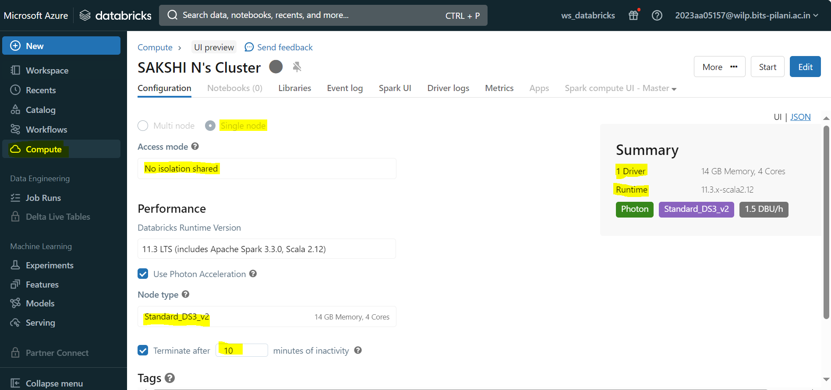
Cluster Configuration Creation

Slide 31
Databricks Notebook & Magic Commands
Databricks Notebook is a collection of cells that run commands on databricks cluster
Magic Commands:
% sql (Converts the cell to sql)
% scala (Converts the cell to scala)
% md (Converts the cell to markdown)
% python (Converts the cell to python)
% fs (Converts the cell to filesystem)

Slide 32
Databricks Utilities
Databricks Utilities makes it easier to combine different types of tasks in a single notebook.
File System Utilities (mount azure storage to db)
Secret Utilities (secrets from key vault)
Widget Utilities (pass parameter into notebook)
Notebook Workflow Utilities (chain notebooks together)
Note: Dbutils vs fs – dbutils provide greater flexibility as it can be combined with other languages such as python , scala and R

Slide 33
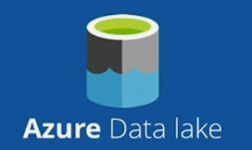
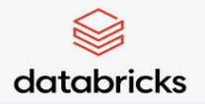

Connect Azure Data Lake Gen 2 with Azure Databricks via Access Keys
Access Keys grant full access to storage account
Each storage account comes with 2 keys (512 bit) which grants full access to storage account
Keys can be regenerated
Access Key
abfs (Azure blob File System)
Azure Data Lake Gen2

Slide 34
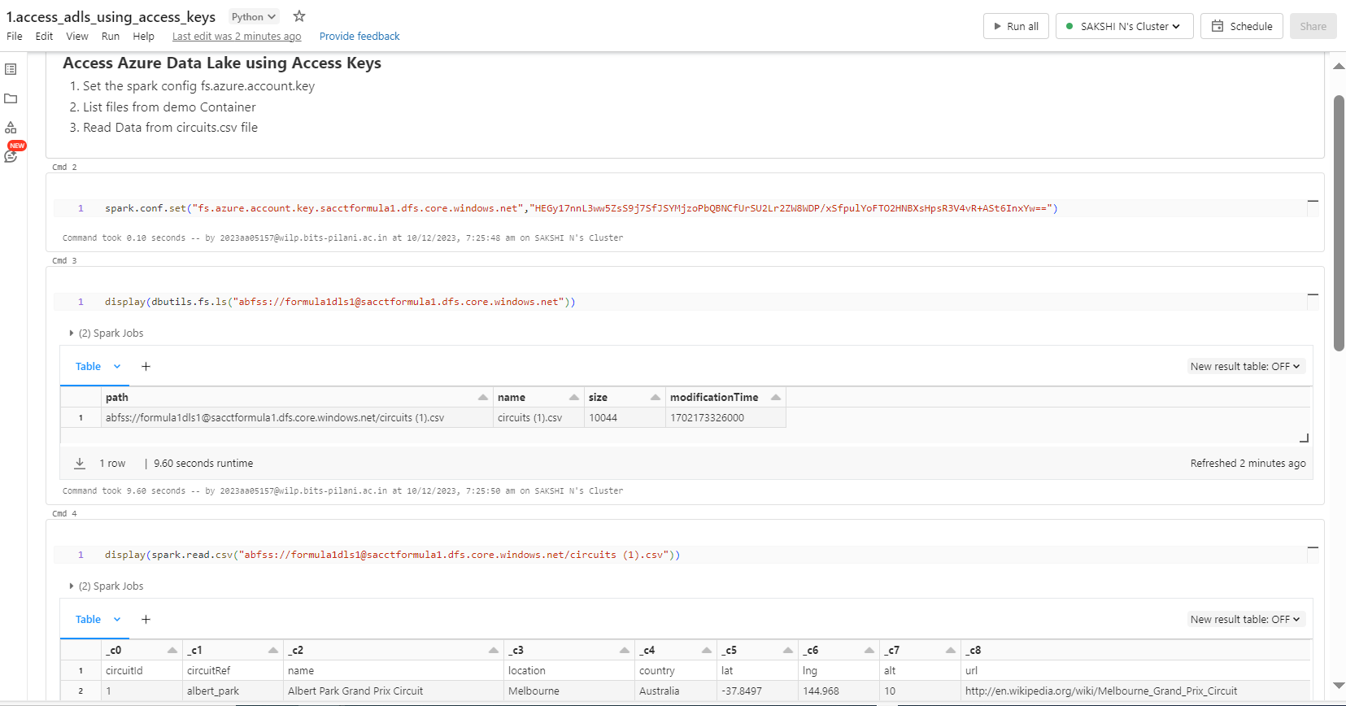
spark.conf.set(“fs.azure.account.key.<storage-account>.dfs.core.windows.net”,”<access key>”)
abfss://container@storage-acct.dfs.core.windows.net/file_name

Slide 35
Connect Azure Data Lake Gen 2 with Azure Databricks via SAS
Provides fine grained access to the storage
Restricts access to specific resource types/Services
Allows specific permission like read, write, list, delete
Restrict access to specific time period
Limits access to specific IP address
Recommended access pattern for external clients
Shared Access Signature(SAS)
Azure Data Lake Gen2

Slide 36
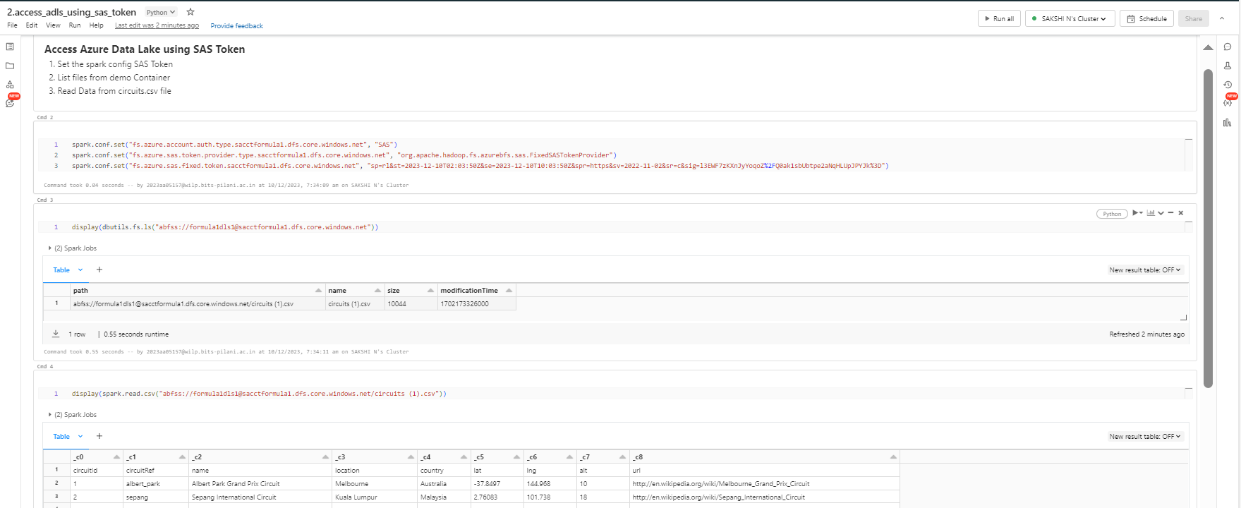
spark.conf.set(“fs.azure.account.auth.type.<storage-account>.dfs.core.windows.net”,”SAS”)
spark.conf.set(“fs.azure.sas.token.provider.type.<storage-account>.dfs.core.windows.net”,”org.apache.Hadoop.fs.azurebfs.sas.FixedSASTokenProvider”)
spark.conf.set(“fs.azure.sas.fixed.token.<storage-account>.dfs.core.windows.net”,”<token>”)

Slide 37
Reason for Mounting Storage Location to DBFS
The previous approach of connecting to blob storage is tedious for two reasons.
Firstly, we need to deal with those along ABFS URLs rather than the file system semantics to access
the files.
Secondly, every time we'll have to use the credentials to authenticate to the storage accounts before
accessing the data from them.
To make this experience better, Databricks allows us to mount these storage accounts to DBFS. We can specify the credential when the storage is mounted.
Once it's mounted, everyone who has access to the workspace can access the data without providing the credentials. Also, they will be able to use the file system semantics rather than the long URLs.
This allows for accessing the Azure storage from Databricks using file semantics rather than the long
storage URLs. You can treat a mount point as the same as mapping another drive to your computer.
DBFS is just an abstraction layer and it still stores the files to the Azure storage, so you get all the benefits such as different performance tiers, replication, massive storage etc., as you would generally get from Azure storage.

Slide 38
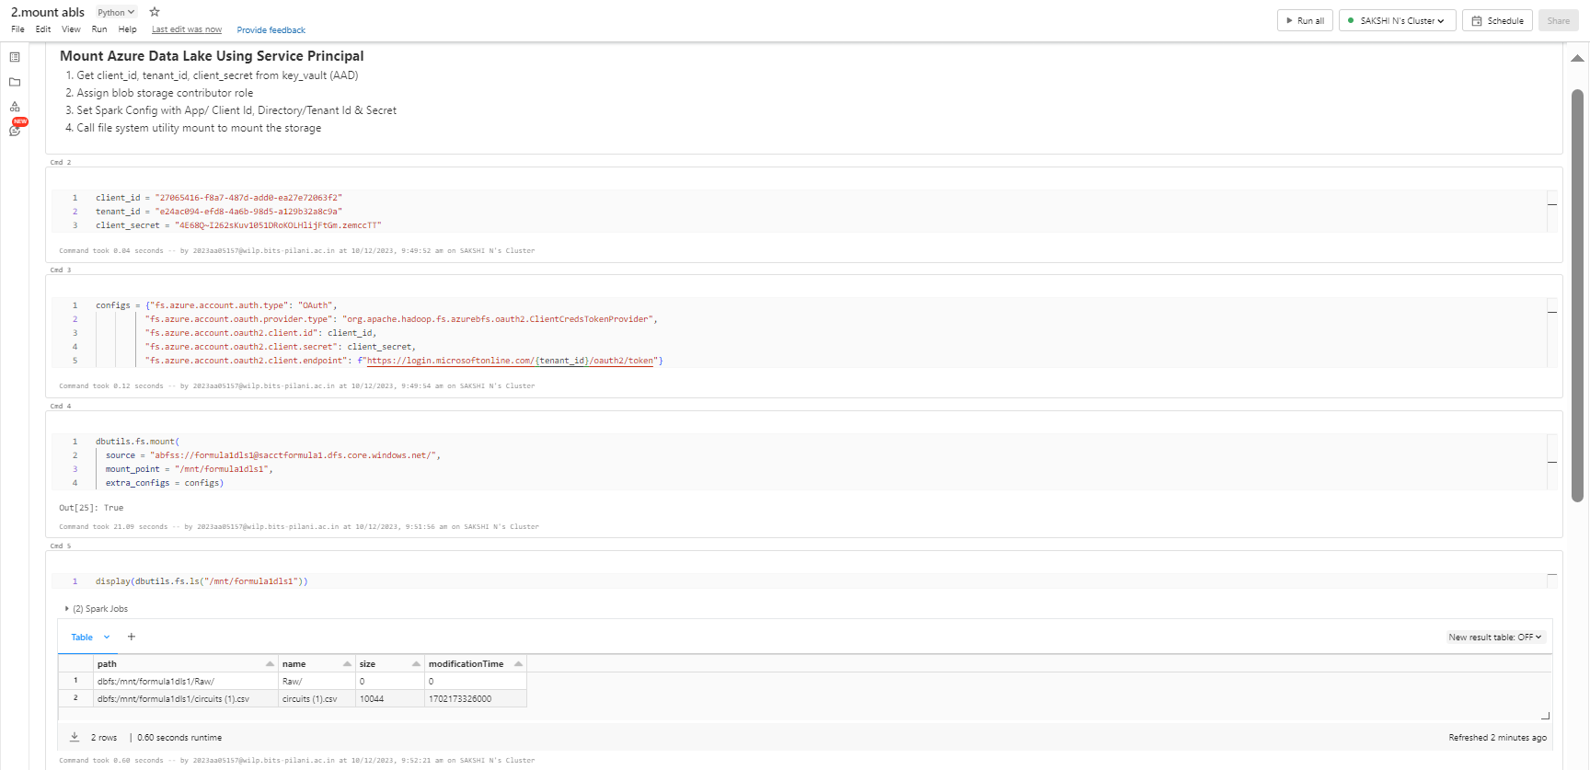
configs = {"fs.azure.account.auth.type": "OAuth",
"fs.azure.account.oauth.provider.type": "org.apache.hadoop.fs.azurebfs.oauth2.ClientCredsTokenProvider",
"fs.azure.account.oauth2.client.id": client_id,
"fs.azure.account.oauth2.client.secret": client_secret,
"fs.azure.account.oauth2.client.endpoint": f"https://login.microsoftonline.com/{tenant_id}/oauth2/token"}
dbutils.fs.mount(
source = "abfss://<Container>@<Storage Acct>.dfs.core.windows.net/",
mount_point = "/mnt/formula1dls1",
extra_configs = configs)

Slide 39
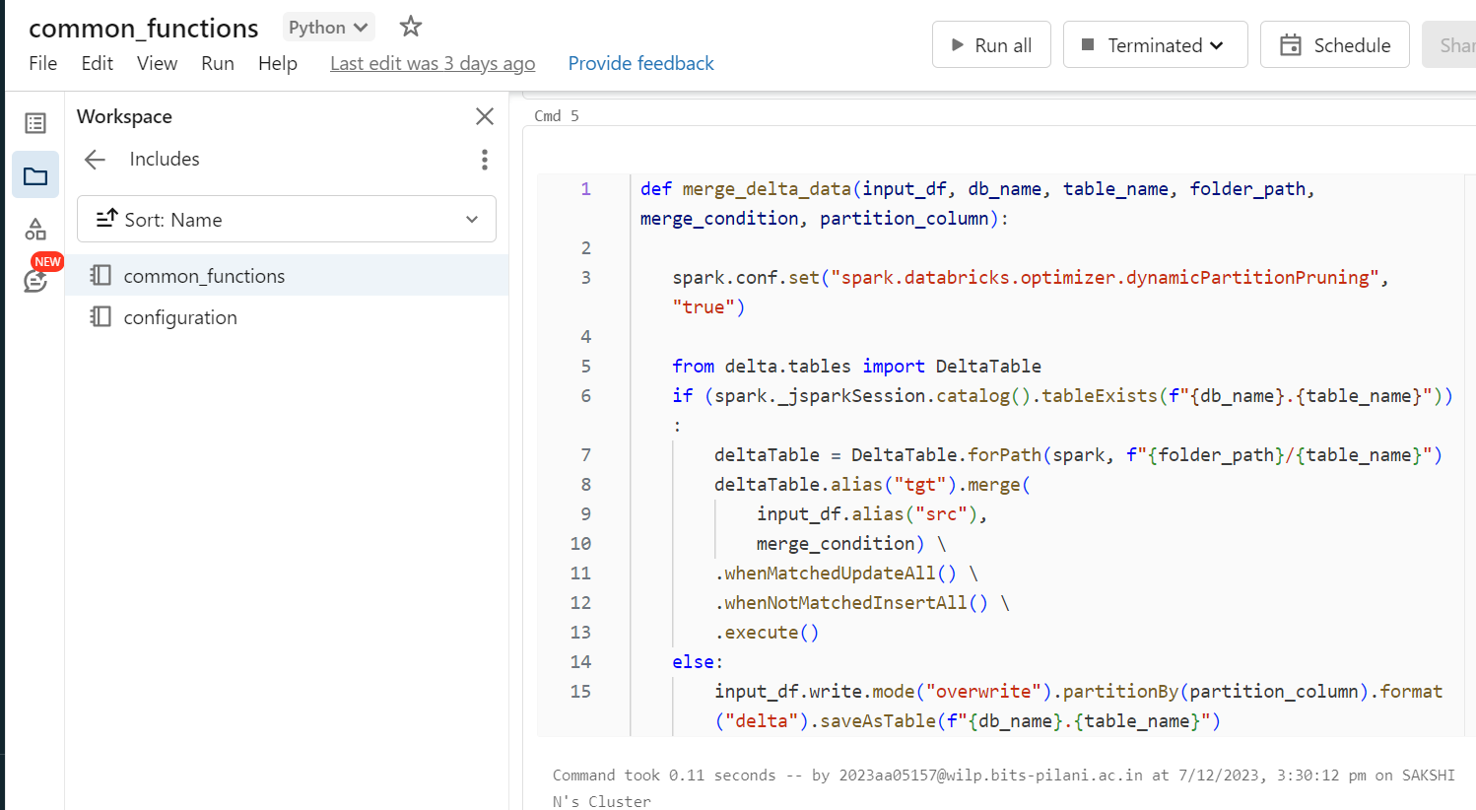
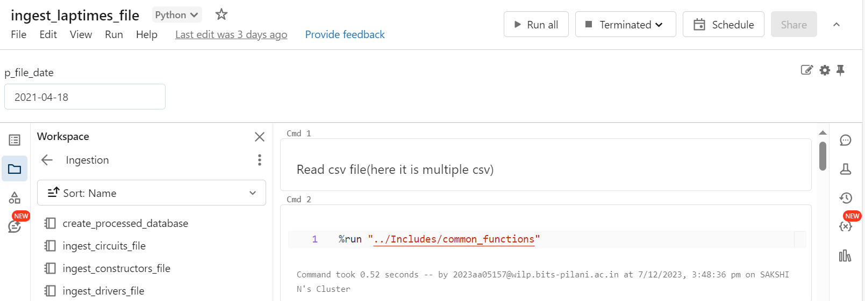
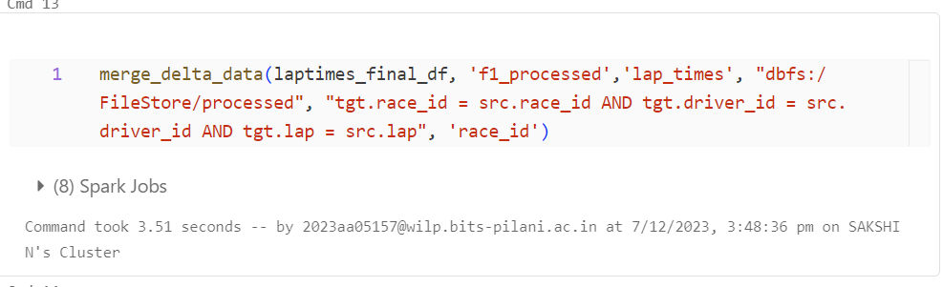
How to call a function in Databricks
Call the notebook using %run magic command
Define function in a notebook (here its called common functions)
Call the function while passing the parameters

Slide 40
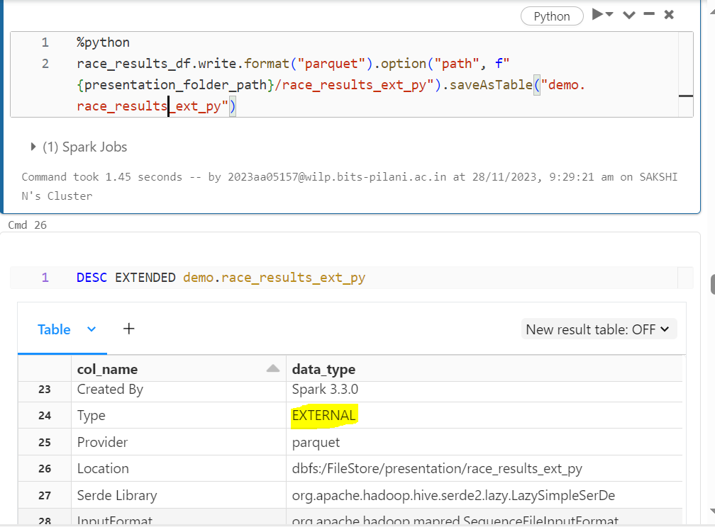
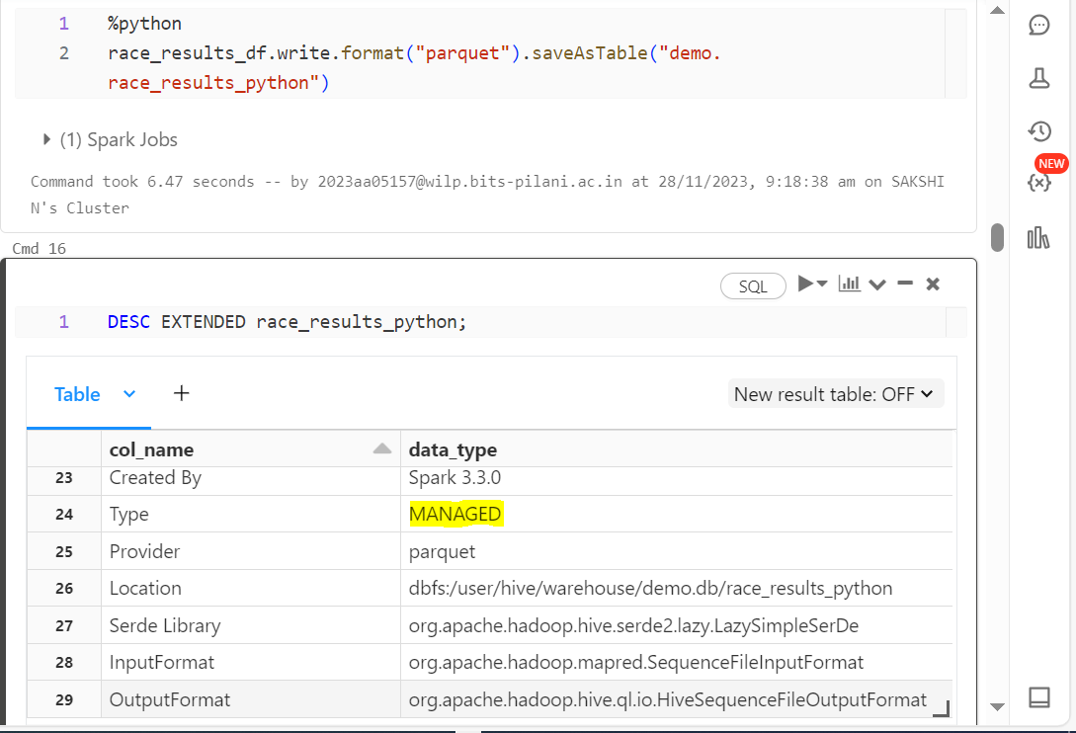
External Table vs Managed Table
External Table: Data is stored outside the databricks dbfs (somewhere like blob) where in the data will be stored in the external location but just the schema is stored in hive metastore. Once the table is deleted in the databricks(dropped) it does not affect the table.
Managed Table : Data is stored in the database inside databricks(cluster memory) where in if the table is dropped then it is deleted permanently with the data

Slide 41
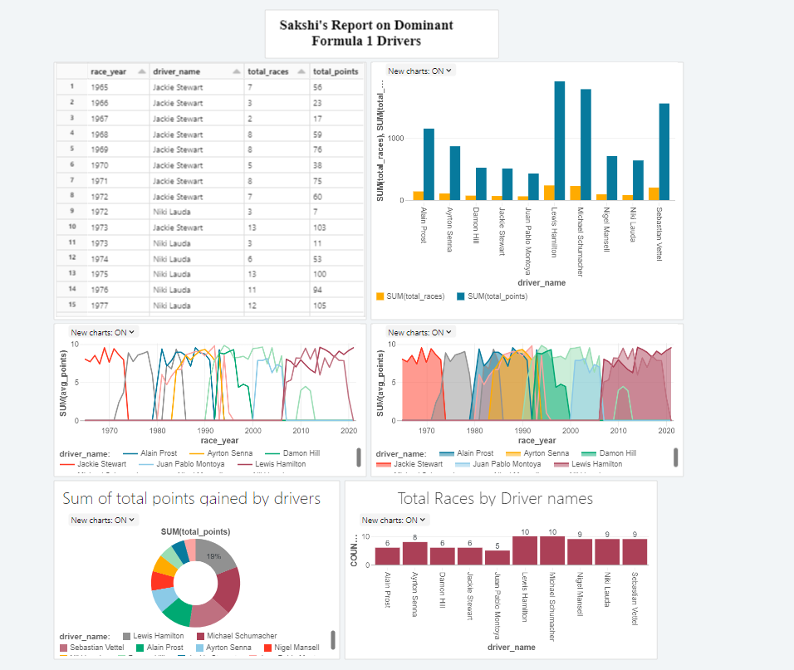
Dashboard in Databricks

Slide 42
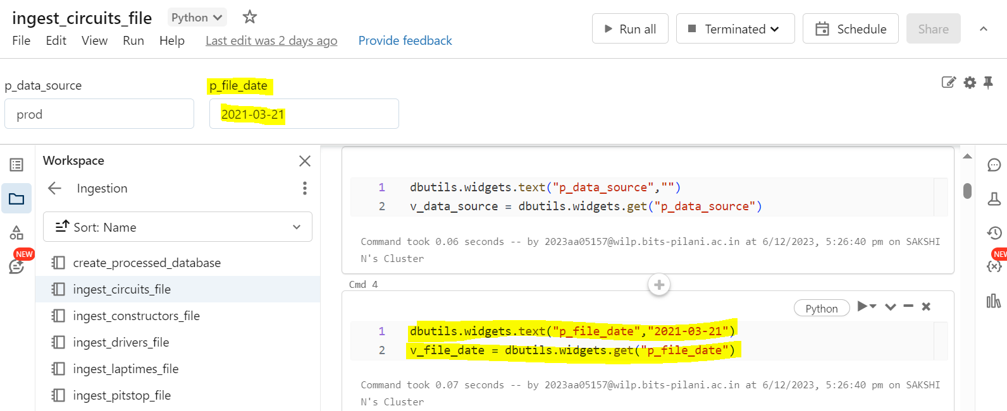
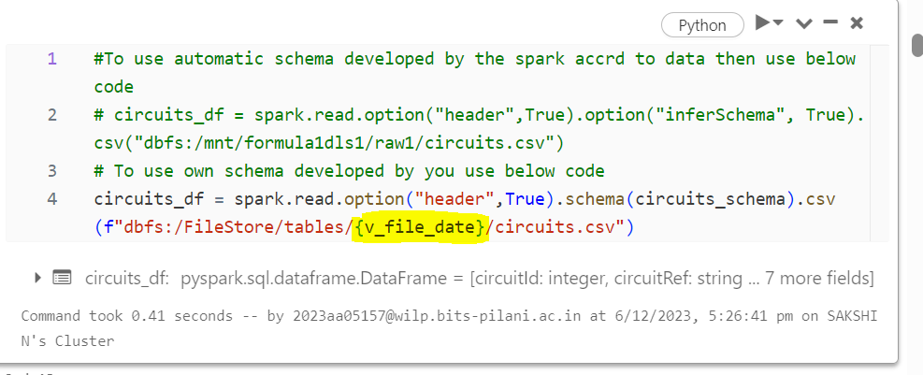
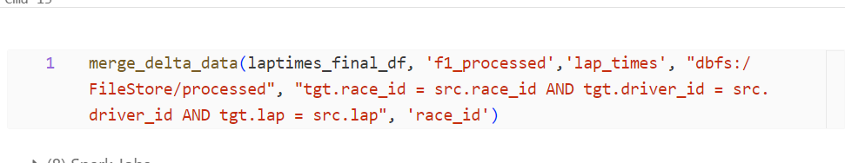
Full Load vs Incremental Load
Full load : It is the complete data from the source.
Incremental Load: It is only the data which is changed recently.
For Incremental load provision was made to input the date parameter to filter the data which was later appended to the original table

Slide 43
Delta Lake
It is a project originally developed by databricks and then open sourced under Linux foundation at 2019
It provides ACID transaction, scalable metadata handling and it unifies streaming as well as batch workloads
Delta Lake runs on top of data lake
Data
Ware House
Data Lake
Data Lake House

Slide 44
Data WareHouses - Problems
Operational Data
ETL
Data Warehouse
Data Consumers
External Data
Unstructured data not supported
Longer to Ingest new data
Proprietary Data Formats
Scalability
Expensive to store data
Lack of support to AI/ML

Slide 45
Data Lake - Problems
Operational Data
Ingest
Data
Lake
Transform
Data
Lake
External Data
Data Science/ ML Workloads
Slow to service BI reports
No support for ACID transaction
Failed jobs leaves partial files
Inconsistent Reads
Unable to handle corrections to data
Unable to rollback any data
Lack of Ability to remove data for GDPR etc
No history or versioning
Poor Performance
Poor BI support
Complex to set up
Lambda Architecture for streaming workloads

Slide 46

Delta Lake - Benefits
Operational Data
Ingest
Delta
Lake
Transform
Delta
Lake
External Data
Data Science/ ML Workloads
Handles all types od data
Cheap cloud object storage
Uses open source format
Support all types of workloads
Ability to use BI tools directly
ACID support
History and versioning
Better Performance
Simple Architecture

Slide 47
Delta Lake - Architecture
BI SQL ML/AI Streaming
Spark
Transf, ML, Streaming etc
Data security, governance, Integrity, Performance
Optimized Engine for performance
History, versioning, ACID time travel
Open file format
Delta Table
Delta engine
Spark
Transaction Log
Parquet Files
Delta Lake stores data in parquet same as data lake
When storing parquet it stores transaction log data which provides history, versioning , Acid
It has delta engine which is spark compatible query engine optimized for performance on delta lakes
Delta table provides data security, governance, Integrity, Performance

Slide 48
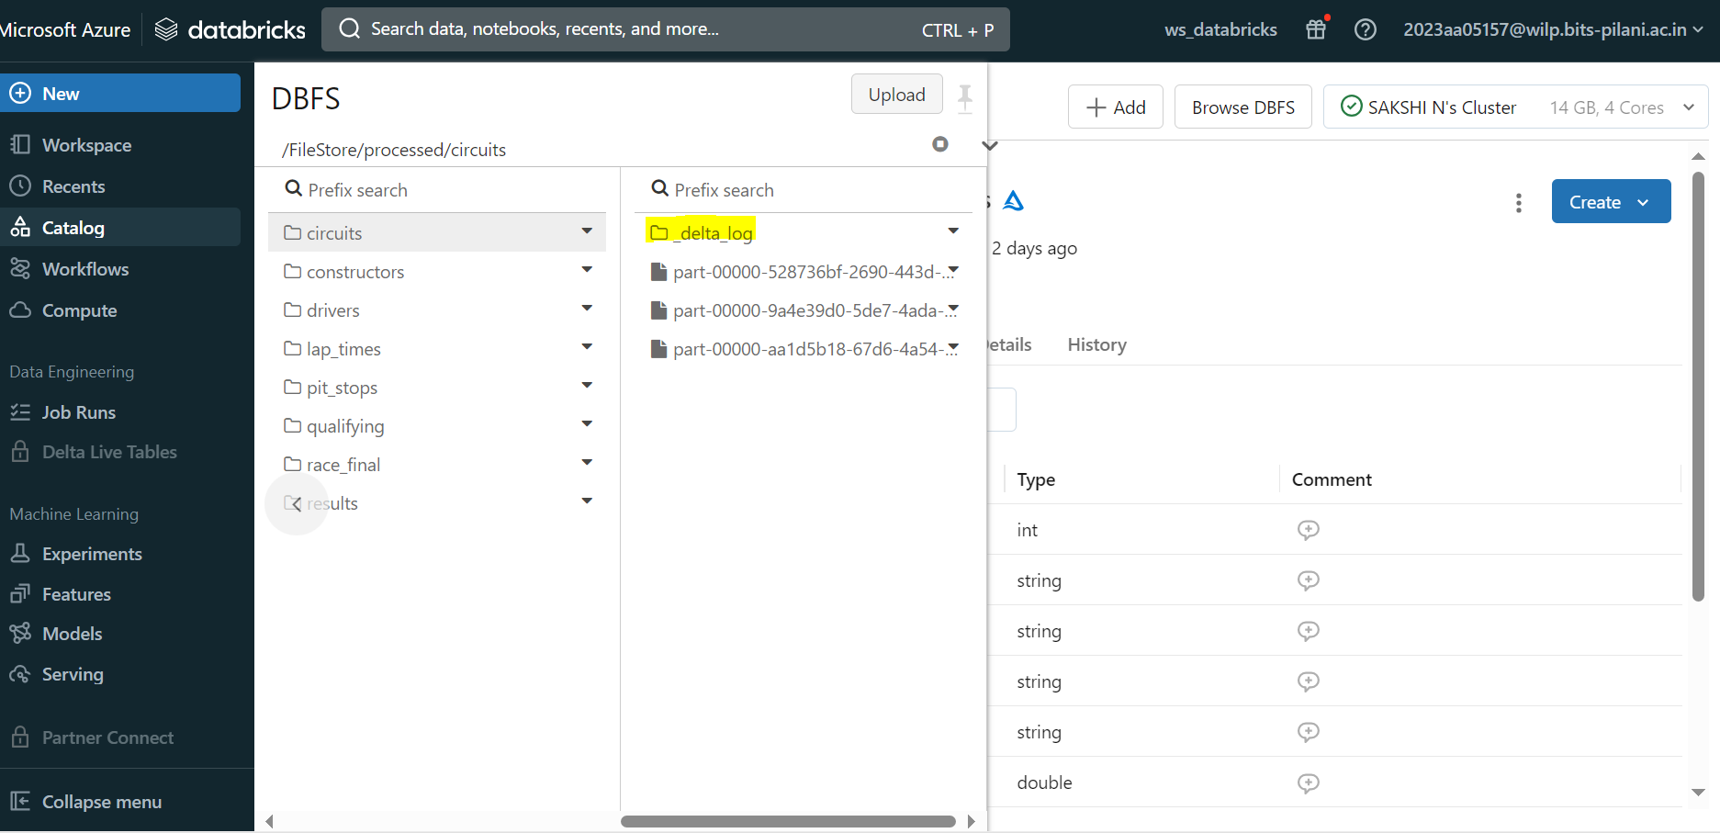
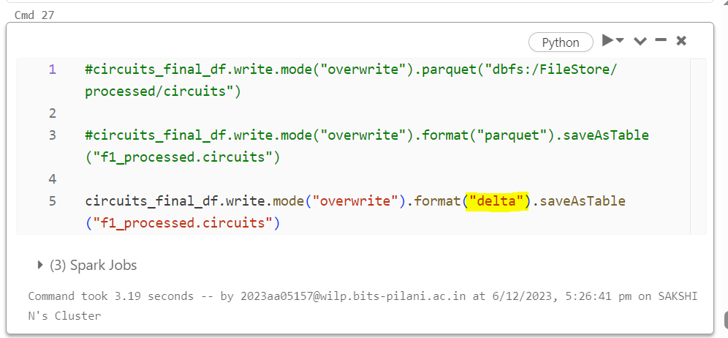
Delta Lake - Table
As observed it is automatically creating the delta log along with the file

Slide 49

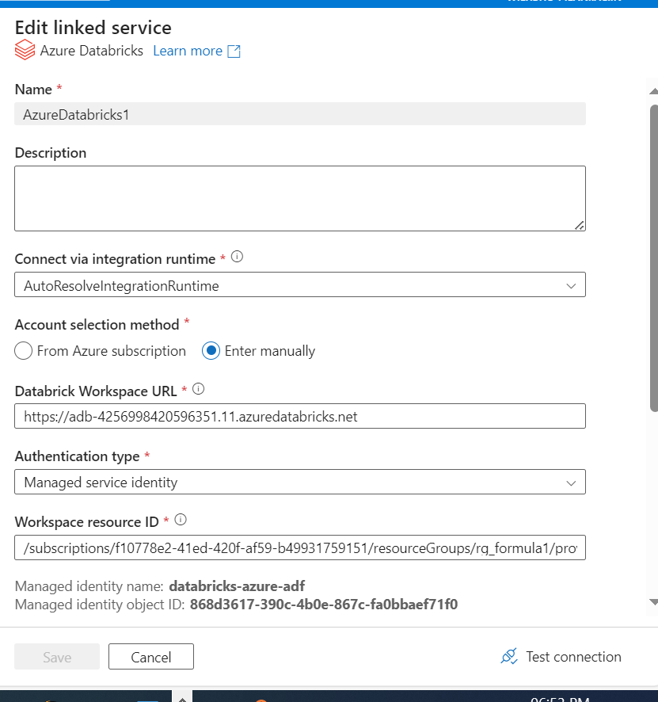
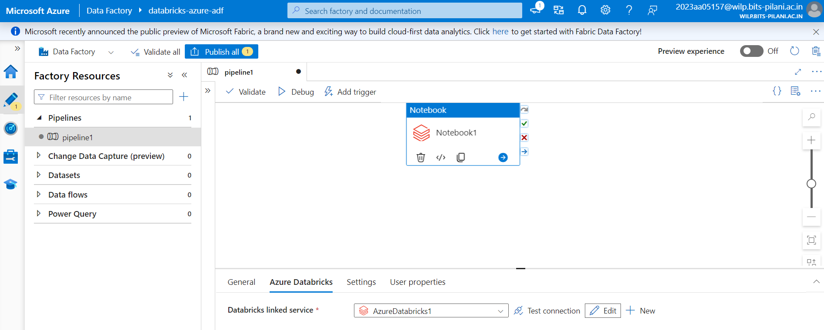
Triggering Databricks Notebook via Data Factory
A Fully managed serverless data integration solution for ingesting, preparing and transforming all of the data at a scale
90 + source connectors are present to ingest data. It also provides ability to transform and analyse the data

Slide 50
Unity Catalog
Unity Catalog is a databricks offered unified solution for implementing data governance in the data lakehouse
Data Governance is process of managing the availability, useability, integrity & security of the data present in an enterprise
Controls access to the data for the users
Ensures the data is trust worthy and not misused helps implement privacy regulations such as GDPR, CCPA etc
Data Access Control
Data Audit
Unity Catalog
Data Lineage
Data Discoverability

Slide 51
Unity Catalog Benefits
Without Unity Catalog
With Unity Catalog
DB WS 1
User Mngmt
Metastore
Compute
DB WS 2
User Mngmt
Metastore
Compute
DB Unity Catalog
User Mngmt Metastore
DB WS 1
Compute
DB WS 2
Compute
Centralized Meta store
Centralized User Management
Centralized Access Control
Searchable Data artifacts (Data explorer)
Data Lineage
Audit Logs

Slide 52
Data Lineage
Data Lineage is the process of tracking the journey of data within a pipeline
Limitations:
Only available for tables registered in unity catalog metastore
Lineage history available only for last 30 days
Limited Column Level lineage

Slide 53
Thank You

